Slide 1

A Step-by-Step Guide to Building a Data-Driven Culture in your Business Using Power BI
Gethyn ellis

Slide 2

















Thank you to our sponsors

Slide 3



About me
Gethyn Ellis
Microsoft, Azure, Power Platform Trainer
www.gethynellis.com
gethyn@gethynellis.com
Twitter: @gethyn_ellis
LinkedIn: https://www.linkedin.com/in/gethynellis/

Slide 4
What we will cover
In this session we will talk about building a data culture including
Establish leadership support
Strategies for overcoming resistance to change
Identify key data stakeholders
Build a data-driven mindset
Implement data governance
Provide training and support
How Power BI can help build that data culture

Slide 5
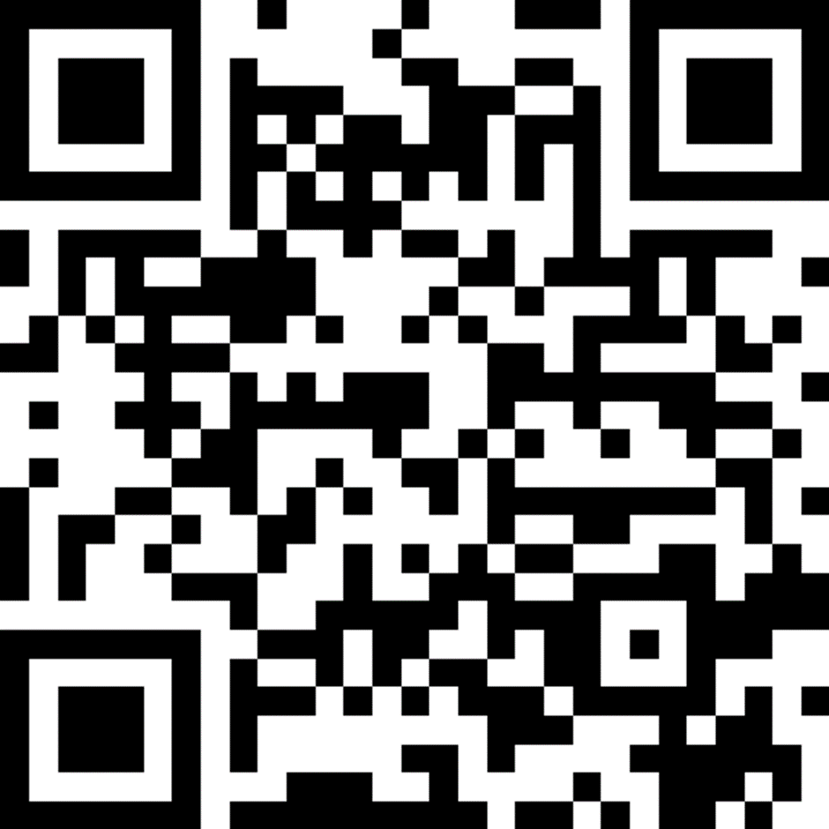
Your feedback is important

Slide 6

Berry Wand – Chief Data Officer

Slide 7

Where to start?

Slide 8

Cultural Change

Slide 9
Change the organisational culture
Assess the current culture
Identify what you desired culture looks like
Develop a plan
Involve employees
Lead by example
Provide training and resources
Monitor the progress

Slide 10
Berry (CDO) Specific Data Culture Challenges
Lack of executive support
Resistance to change
Siloed data
Data quality
Lack of data literacy
Security and privacy concerns
Limited resources

Slide 11

Berry discusses them with a consultant she met a conference

Slide 12


Step by Step Guide to building a data culture
Establish leadership support
Overcome resistance to change
Build a data-driven mindset
Identify key stakeholders
Implement good data governance
Invest in data infrastructure
Provide training

Slide 13
How to establish leadership support
Demonstrate the value of the data
Develop a clear data strategy

Slide 14
Strategies for overcoming resistance to change
Communicate the benefits
Involve employees in the change process
Address concerns and fears
Provide clear guidance
Celebrate success
Lead by example

Slide 15
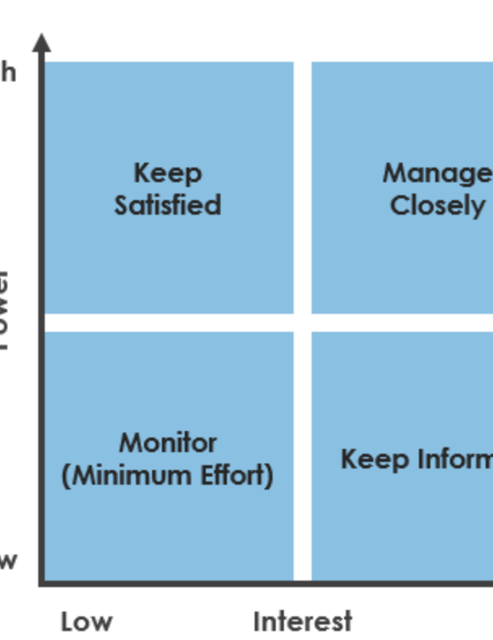
Who are the key stakeholders for building a data-driven culture?
Executive leadership team
IT department
Data management team
Data analysts
Business leaders
Frontline staff
Customers

Slide 16
Build a data-driven mindset
Educate employees on the importance of data
Provide literacy training
Use data to demonstrate the impact using real-life examples
Make data accessible
Encourage experimentation
Develop data champions
Data-driven decision making

Slide 17
What data governance do you need to build a data culture
Data privacy and security
Data quality management
Data access and sharing
Data retention and archiving
Integration and interoperability
Ownership and accountability
Governance board

Slide 18
Enabling self-service analytics
Provide access to the data
Simplify access to the data
Provide training and support
Encourage collaboration
You’ll need governance
Provide a feedback mechanism

Slide 19
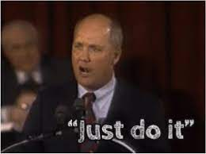
Art Williams : Just DO It
“I think it’s almost impossible for a smart person to win in business in America today, because I find smart people spend their whole lifetime figuring things out. They always trying to figure out an easier way, and a quicker way. And another thing I found out about smart people, is they just don’t get around to doing nothing.”

Slide 20

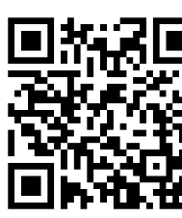
How do you build a data culture?
Ask Art Williams
“You just do it”
“You got to be tough and you can’t quit”
“You got to be a leader”
“You do whatever it takes to get the job done”
What’s the primary difference between winners and losers? The winners do it, and do it, and do it, and do it….until the job gets done

Slide 21

What’s Power BI got to do with this Anyway
What makes building a data culture difficult
Lack of executive support
Resistance to change
Siloed data
Data quality issues
Lack of data literacy
Security and privacy concerns

Slide 22

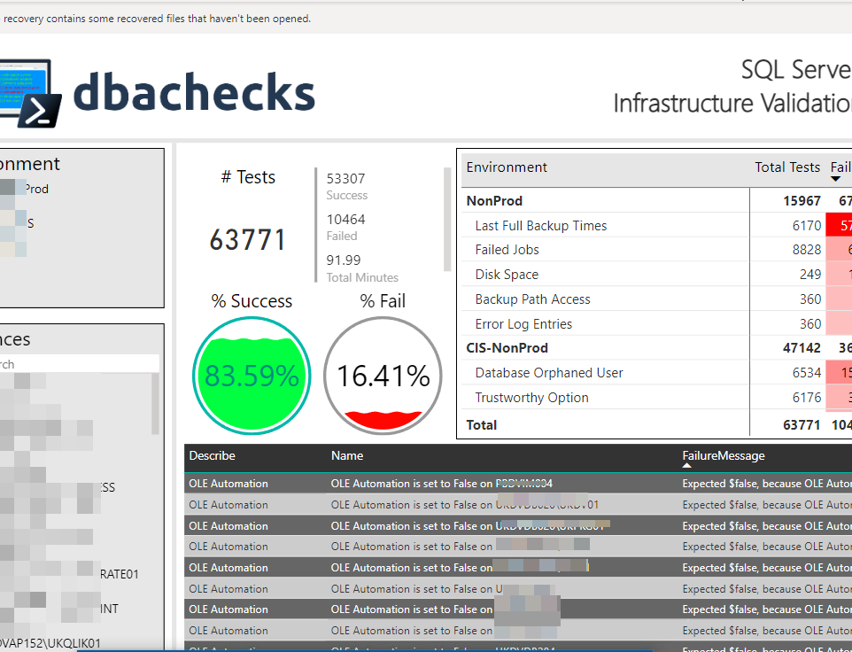
Power BI – Fixing Siloed Data
Build a unified data
Connect to a wide range of data
Build a model that relates all data from that set
Share across the organisation

Slide 23

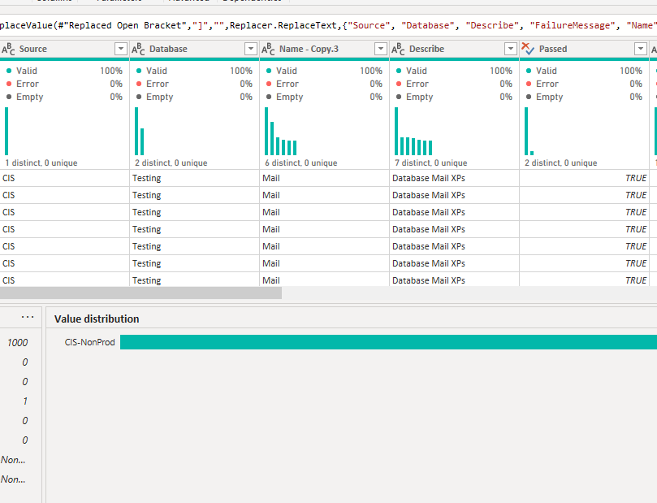
Power BI Data Quality Issues
Power BI and Power Query can help in a number of ways
Data Profiling
Data Cleansing
Data Modelling

Slide 24
Lack of Data Literacy
Training and resources
Collaboration
Visualisation
Self-service

Slide 25
Power BI Security and Privacy Concerns
Role based security
Row-level security
Encryption
Compliance and certifications
Microsoft Purview Information Protection
Classification
Labelling
Protection
Monitoring and reporting

Slide 26

Training and Support
Centre of Excellence

Slide 27
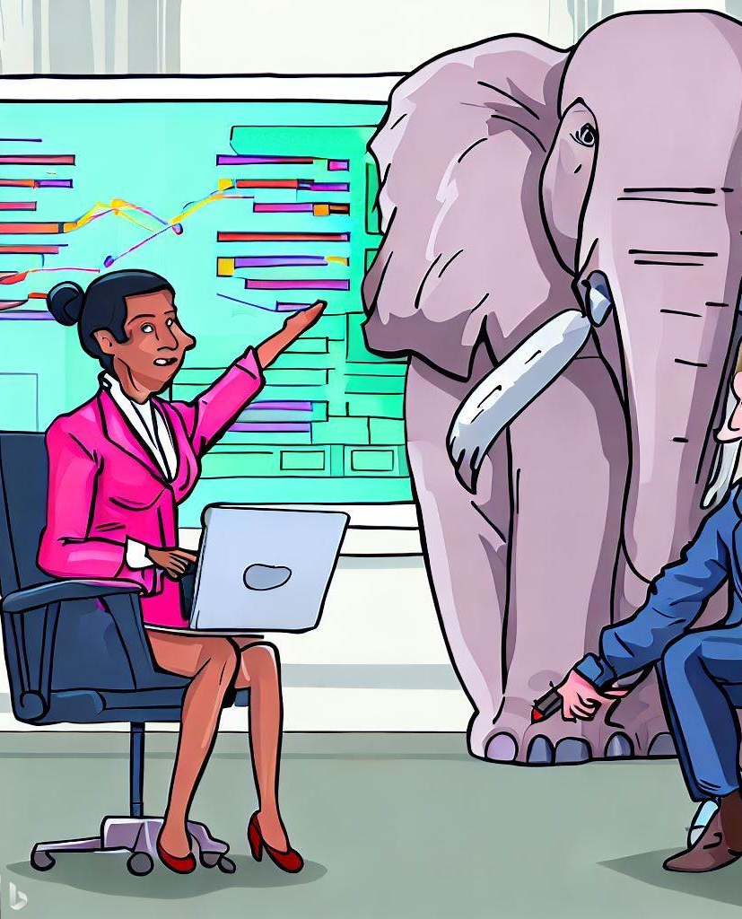
What About the elephant in the room
What makes building a data culture difficult
Lack of executive support
Resistance to change
Siloed data
Data quality issues
Lack of data literacy
Security and privacy concerns

Slide 28
What About the elephant in the room
What makes building a data culture difficult
Lack of executive support
Resistance to change

Slide 29

What Berry Did
She embraced her inner Art Williams – She just did it
She found a new sponsor
She over resistance to change by demonstrating the value it could bring in small increments
She build a centre of excellence which allowed the data culture and the technology skills needed to nurture and develop

Slide 30
Nobody wants a data culture
They want the benefit it brings
Build executive support by showing it can align to the business strategy and objectives
Start small

Slide 31
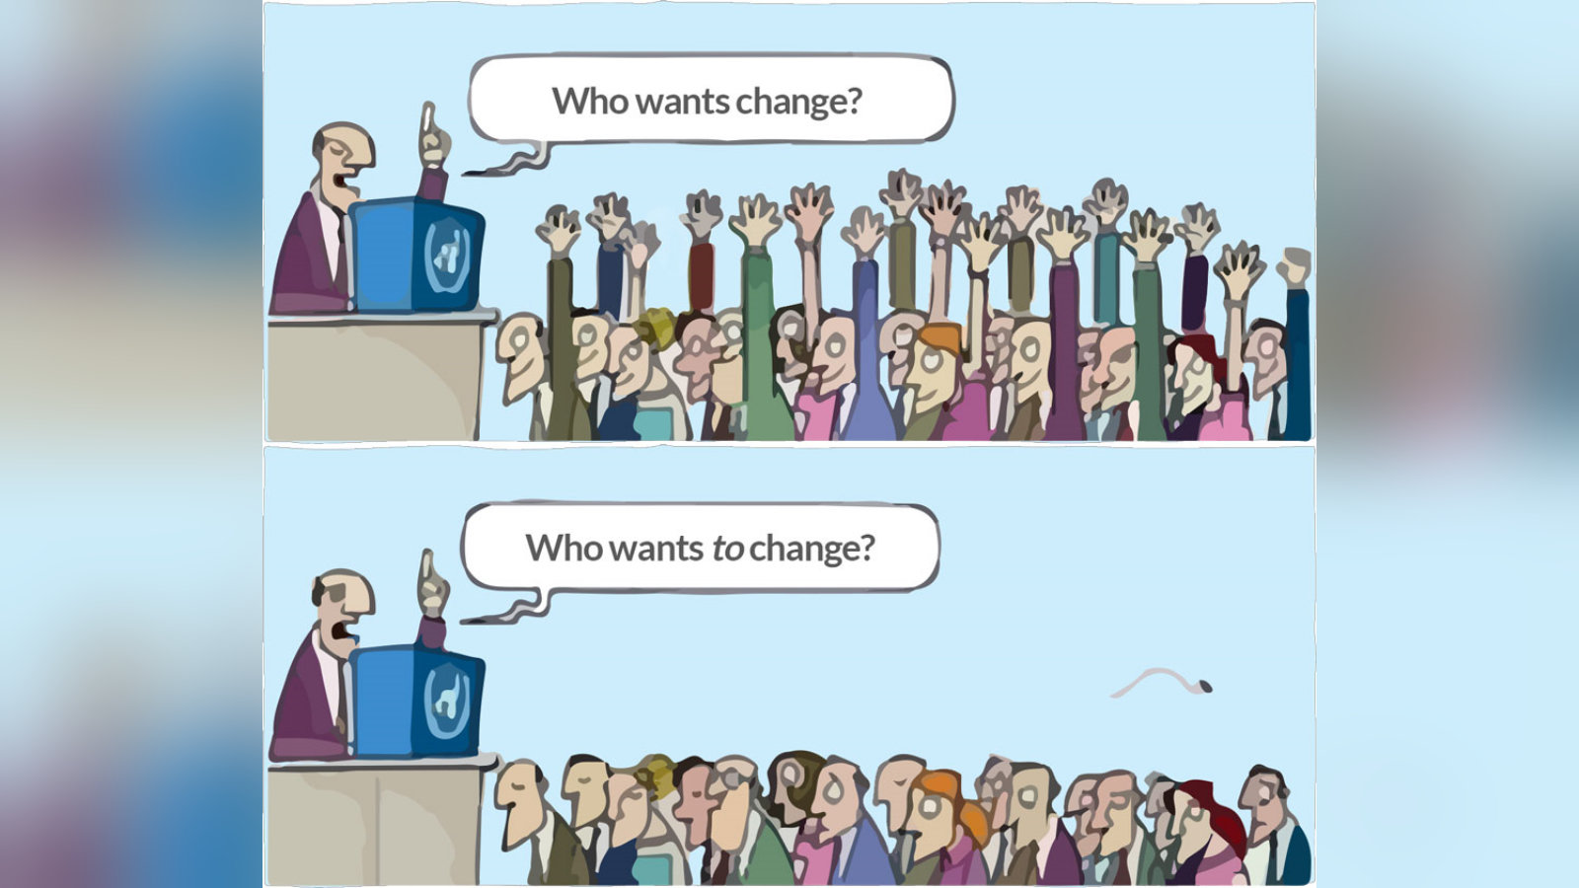
Resistance to change

Slide 32




Use cases and examples
This Photo by Unknown Author is licensed under CC BY-SA-NC
This Photo by Unknown Author is licensed under CC BY-NC
This Photo by Unknown Author is licensed under CC BY-SA
This Photo by Unknown Author is licensed under CC BY-NC

Slide 33
You are not or your own
You want to thrive in today’s data driven world
We can help you
gethyn@gethynellis.com

Slide 34
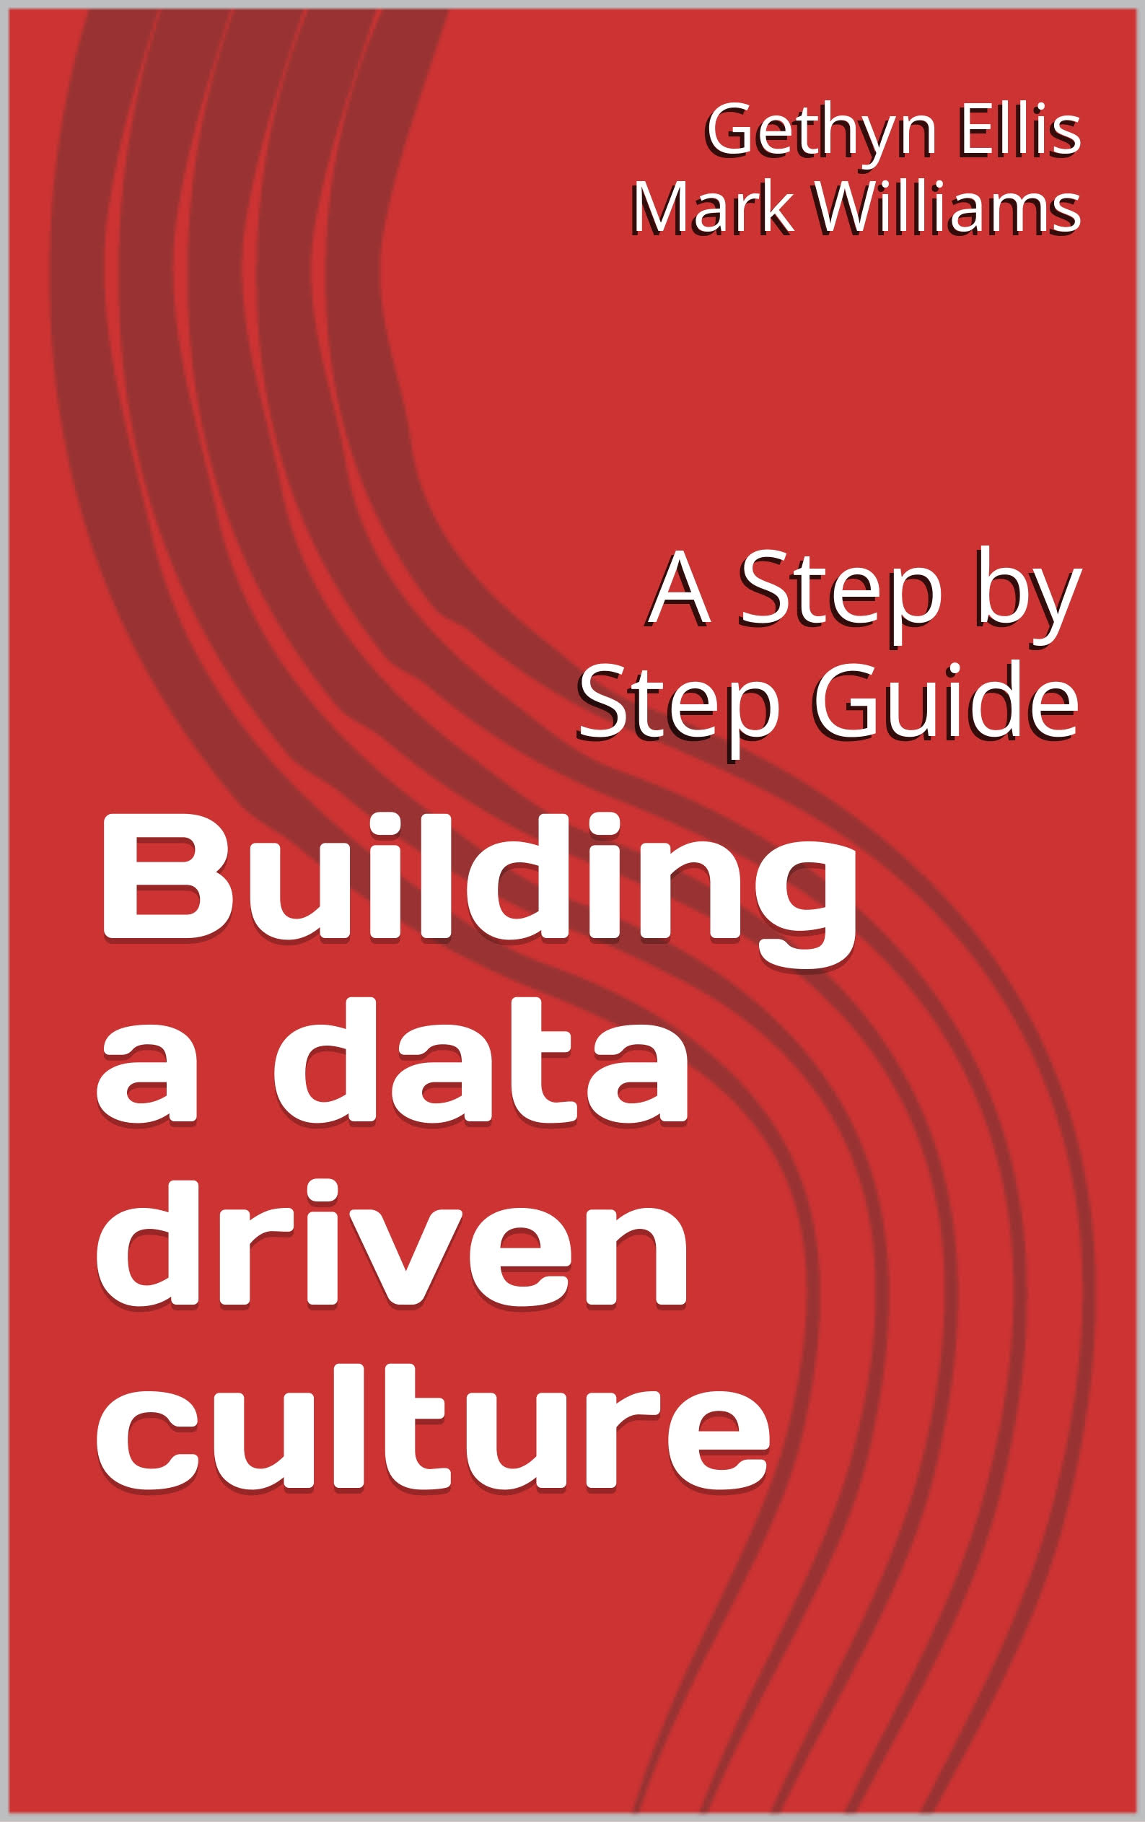
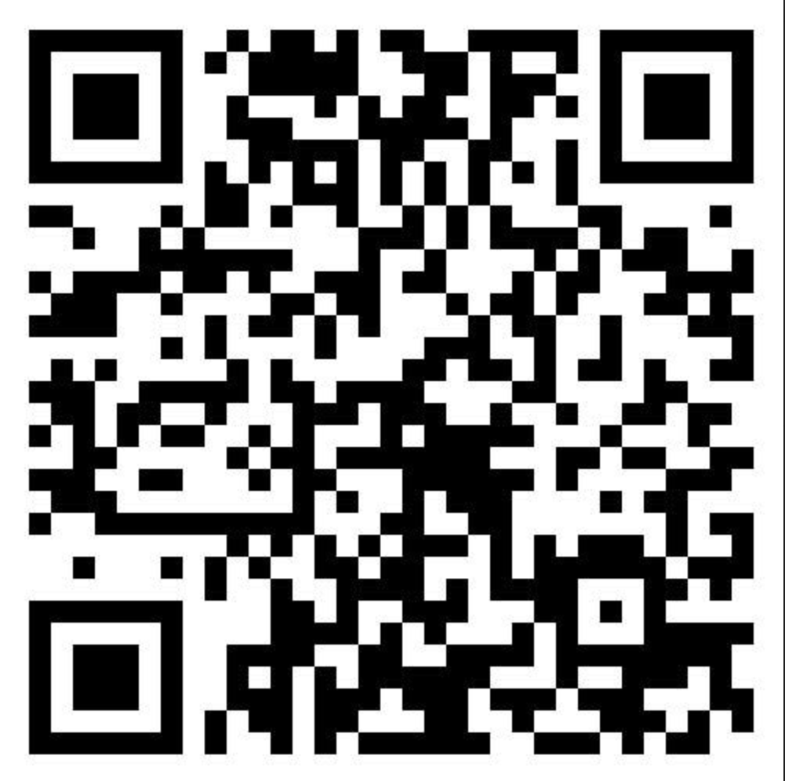
Buy our book

Slide 35

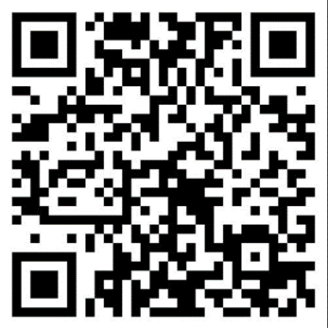
Questions Discussion

Slide 36
Your feedback is important

